Slide 1
Aerospike and Zipf Model
Caching tier model validation with Aerospike database
Ruchi Gupta
8/31/18

Slide 2
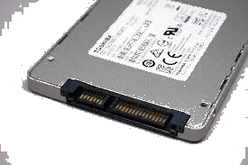
Purpose?
Evaluating enterprise data applications to select the right workloads for SSDs and XL NAND
Evaluating the trade off between SCM and XL NAND based on cost parity

Slide 3
Pre-FMS work
Used the Zipf model to compare SCM vs SSD
Implemented the effect of writes on read latency in the Python-based analytical model to demonstrate caching tier efficacy with mixed workload

Slide 4

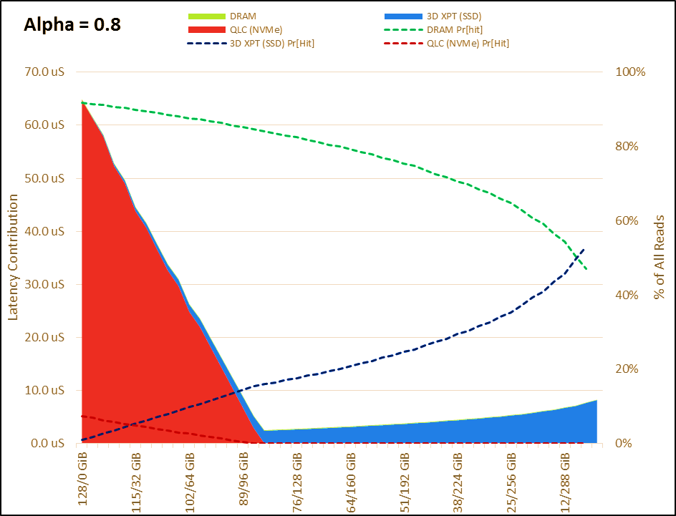
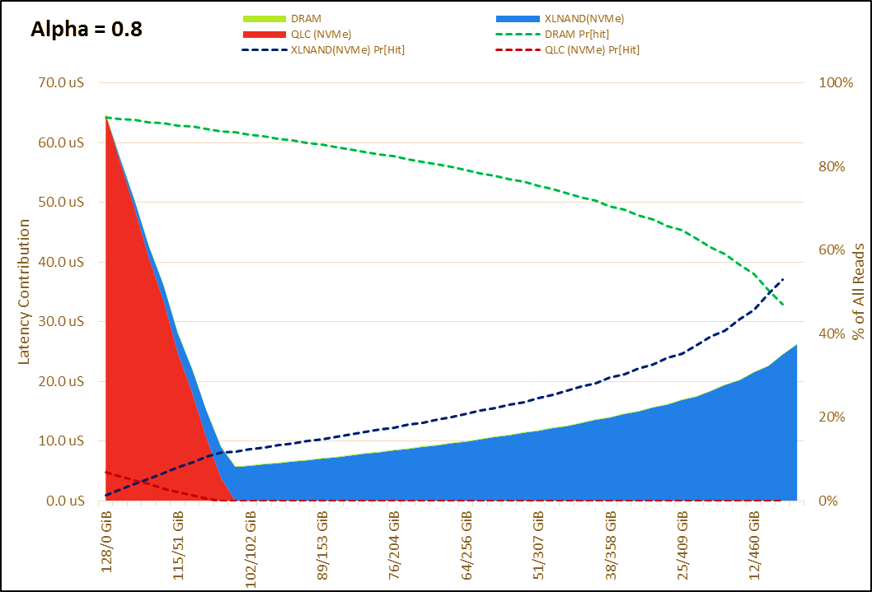
XL NAND SSD vs Optane with QLC SSD – Analytical Model
70/30 read/write mix
192 GiB active addressable range out of a 4TiB dataset
Optimum latency is ~2.7us for Optane vs 6 us for XL NAND

Slide 5
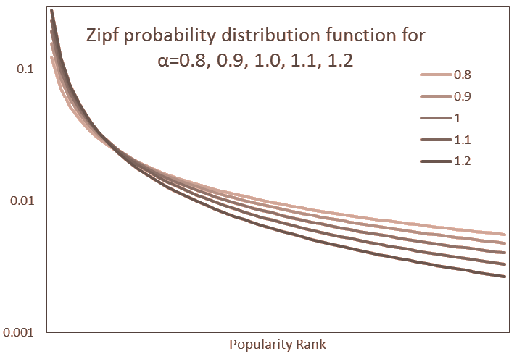
What is the Zipf Model?
$$Pr\left(r\right)∼\frac{1}{r^{α}}$$
$r$=popularity rank
$α$ = tunes how fast popularity falls off
Highest Zipf-ian coefficient ($α$) has the most concentrated data set
Smaller Zipf-ian coefficient ($α$) approaches uniform random distribution

Slide 6

What is ACT?
Aerospike: fast columnar database (meta-data stored in DRAM)
ACT(Aerospike Certification Tool) is a proxy for Aerospike database workload
used to benchmark latency tests under larger write loads.
Assists in determining best SSDs for big data needs in real-time
ACT performs a combination of 128K block r/w and 1.5K block reads, stimulating loads
for further info: https://github.com/aerospike/act/blob/master/README.md
Notes:
In memory data base computer main memory for data storage
using a proxy
did not install data base
stimulating the loads, read and writes are real to the ssd

Slide 7
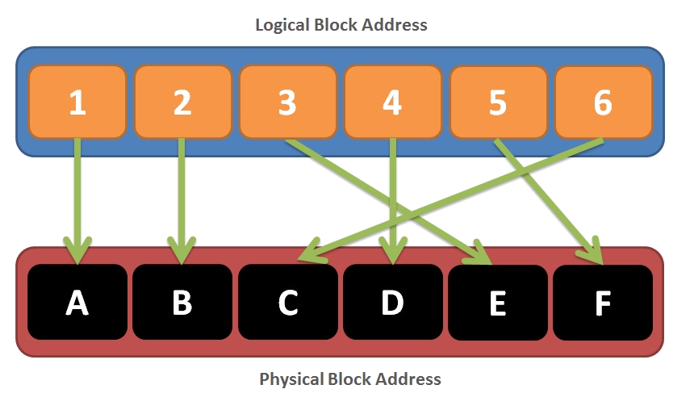
Blktrace?
Tool that traces I/O transactions on block devices in a Linux system
Each drive, has a block of stored data that is given a logical block address (LBA)
Once the ACT sends a read or write command to the drive, it tells the drive to read or write the data located at one or more LBAs
Blktrace tool makes it possible to record the starting LBA and transfer size, for each request sent to the drive

Slide 8
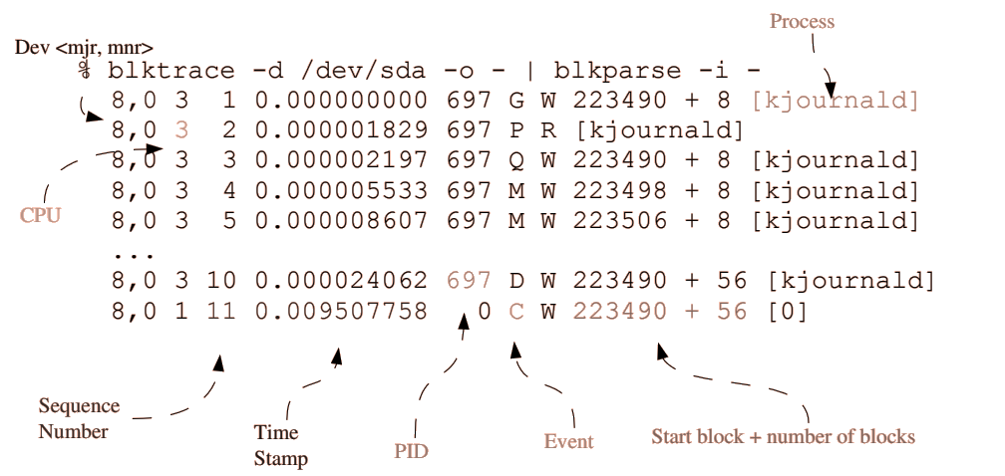
Blktrace sample output:

Slide 9
Experimental Setup
R/W latency is measured for a long period of time (24 hrs) to evaluate drive stability and overall performance
Traffic/Loading
To prevent memory errors arising from large loads, we used mkfifo to create pipes and transfer data between processes
Enabled line by line processing, without actually storing data, thus saving memory.
 | Loads | Reads per sec | Writes per sec
1x | Normal | 2000 | 1000
6x | Medium | 12000 | 6000
12x | High | 24000 | 12000

Slide 10
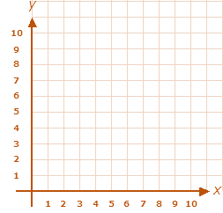
Measured results
Used LBA frequency to graph the results
Normalized sorted counts to probability of access
# of access
indices: sorted by # of access
Notes:
# of access
indices sorted by # of access

Slide 11
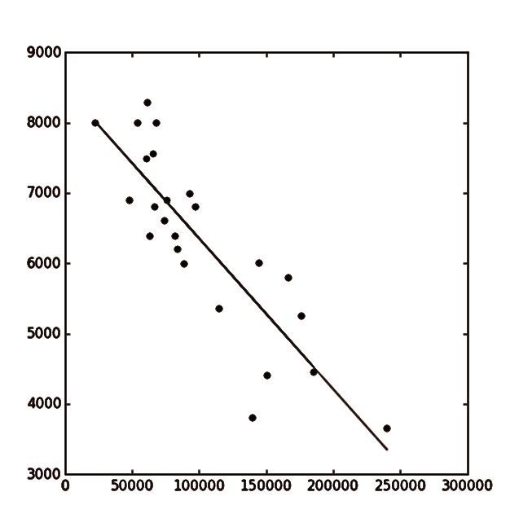
Using Zipf model to interpret measured results
Goal: find the best fit curve (curve fitting)
Observation: Zipf model is best for database access
Plot the points as log to find alpha
Used linear regression to find the best fit line
alpha = slope of line
Notes:
observed that it is a zipf model, best fit for database access,
converting to log scale helps model

Slide 12
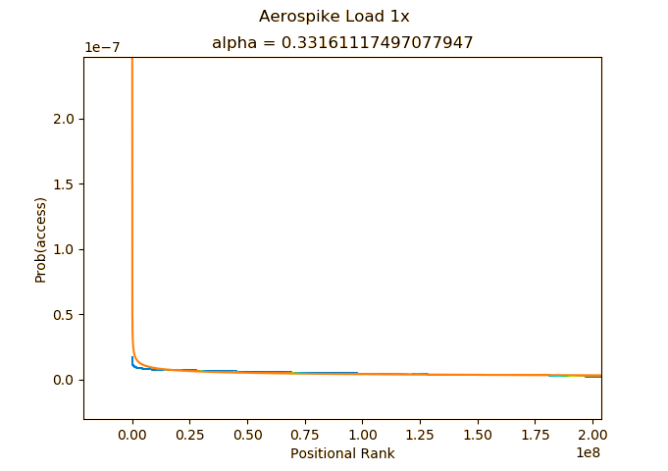
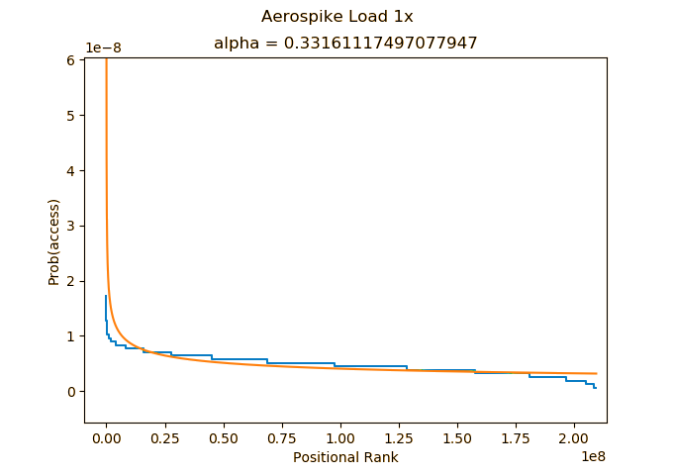
Results: Aerospike load 1x
Observations: More concentrated access compared to 6x/12x, fat tail
Notes:
add observations : more concentrated access (6x,12) fat tail

Slide 13
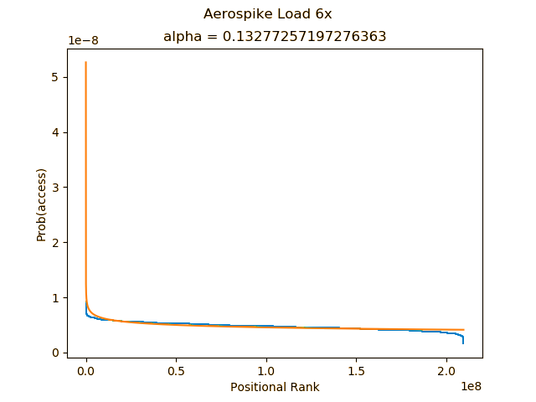
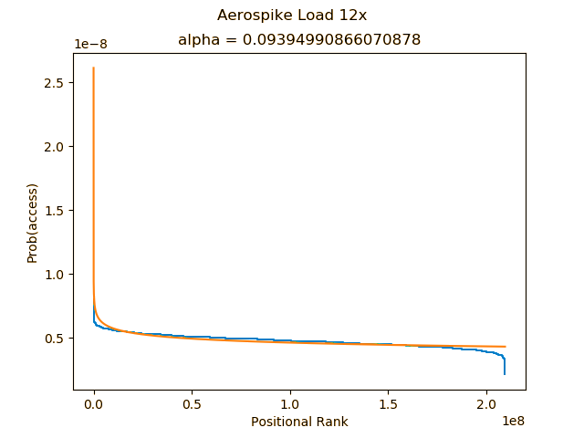
Results: Aerospike load 6x and 12x
Observations: data fits well, therefore the Zipf’s approximation is well suited for the measured data
Notes:
data fit well: therefore zipf model is approx is fit

Slide 14
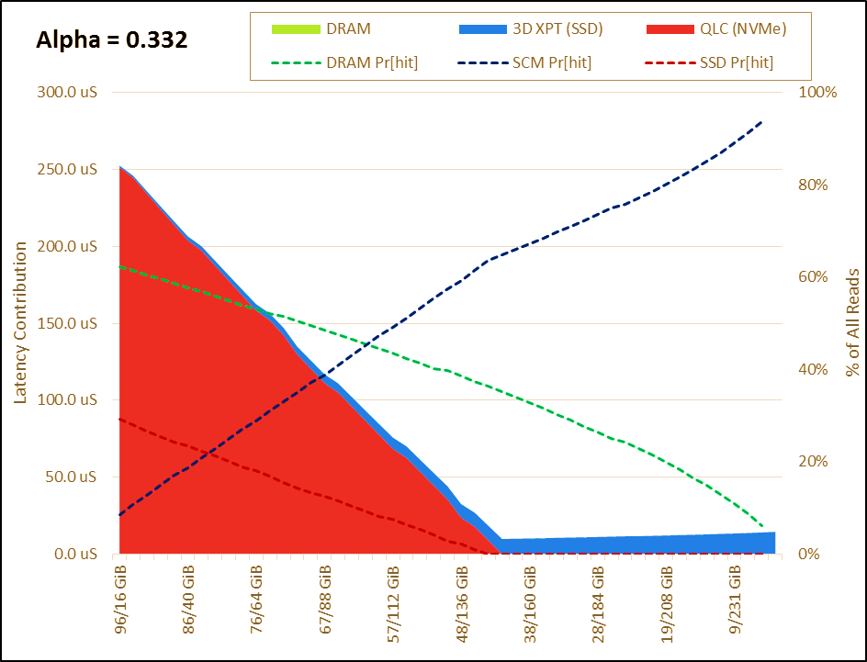
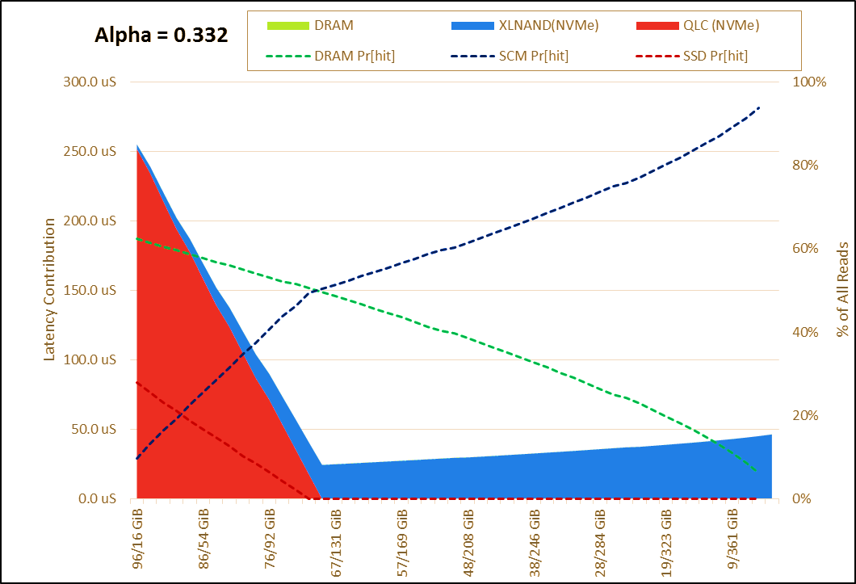
XL NAND SSD vs Optane with QLC SSD – Aerospike results
70/30 read/write mix
192 GiB active addressable range out of a 4TiB dataset
Optimum latency is ~9.9us for Optane vs 25.1 us for XL NAND
Notes:
realistic workload like aerospike,

Slide 15


Takeaways
Technical Observations:
Zipf model is a suitable representation of realistic database workloads
XL NAND SSDs can provide close to Optane performance
This work could be used as a basis for future marketing collateral
Lessons learned:
Experience in utilizing the Zipf model to demonstrate advantage
Methods of compressing big data
Schemes for curve-fitting empirical data to analytical models
Applying learnings of stats class in a real-world implementation
Notes:
personal experience gained?
tie back to school work?
results: use for marketing collateral

